Slide 1
Object-Oriented Analysis and Design using JAVA
B.Tech (CSE/IT) 5th SEM
2020-2021
Lecture-20 Activity diagram

Slide 2
Introduction
An activity graph is a special form of state machine intended to model computations and workflows.
The states of the activity graph represent the states of executing the computation, not the states of an ordinary object. Normally, an activity graph assumes that computations proceed without external event-based interruptions (otherwise, an ordinary state machine may be preferable).
An activity graph is a special form of state machine intended to model computations and workflows. The states of the activity graph represent the states of executing the computation, not the states of an ordinary object. Normally, an activity graph assumes that computations proceed without external event-based interruptions (otherwise, an ordinary state machine may be preferable).
Reference: Unified Modeling Language (UML): Complete Guide & Examples -By James Rumbaugh, Ivar Jacobson, Grady Booch

Slide 3
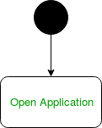


Activity diagram notation
Initial State – The starting state before an activity takes place is depicted using the initial state. This initial state is depicted using a black filled circle. For objects, this is the state when they are instantiated. The Initial State from the UML Activity Diagram marks the entry point and the initial Activity State.
Action or Activity State – An activity represents execution of an action on objects or by objects. It is represented using using a rectangle with rounded corners. Basically any action or event that takes place is represented using an activity.
Reference: https://www.geeksforgeeks.org/unified-modeling-language-uml-activity-diagrams/

Slide 4
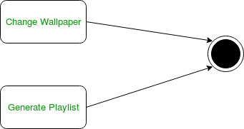
Action Flow or Control flows – Action flows or Control flows are also referred to as paths and edges. They are used to show the transition from one activity state to another. An activity state can have multiple incoming and outgoing action flows. A line with an arrow head is used to depict a Control Flow. If there is a constraint to be adhered to while making the transition it is mentioned on the arrow.
Consider the example – Here both the states transit into one final state using action flow symbols
Reference: https://www.geeksforgeeks.org/unified-modeling-language-uml-activity-diagrams/

Slide 5
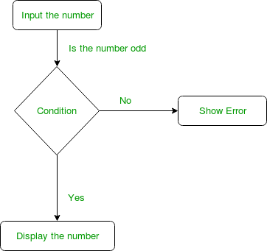
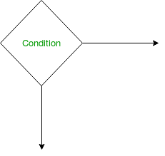
Decision node and Branching – When we need to make a decision before deciding the flow of control, a decision node is used to represent it. The outgoing arrows from the decision node can be labelled with conditions or guard expressions. It always includes two or more output arrows.
Reference: https://www.geeksforgeeks.org/unified-modeling-language-uml-activity-diagrams/

Slide 6
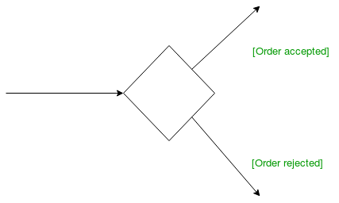
Guards – A Guard refers to a statement written next to a decision node on an arrow sometimes within square brackets.
The statement must be true for the control to shift along a particular direction. Guards help us know the constraints and conditions which determine the flow of a process.
Reference: https://www.geeksforgeeks.org/unified-modeling-language-uml-activity-diagrams/

Slide 7
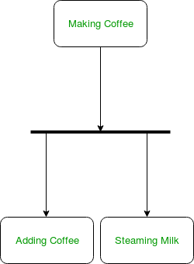
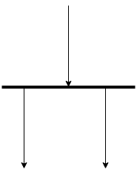
Fork – Fork nodes are used to support concurrent activities. When we use a fork node when both the activities get executed concurrently i.e. no decision is made before splitting the activity into two parts.
Both parts need to be executed in case of a fork statement.
We use a rounded solid rectangular bar to represent a Fork notation with incoming arrow from the parent activity state and outgoing arrows towards the newly created activities.
For example: In the example below, the activity of making coffee can be split into two concurrent activities and hence we use the fork notation.
Reference: https://www.geeksforgeeks.org/unified-modeling-language-uml-activity-diagrams/

Slide 8
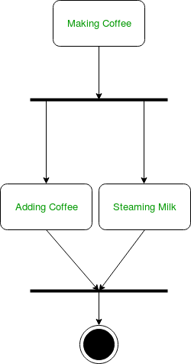
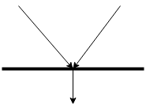
Join – Join nodes are used to support concurrent activities converging into one. For join notations we have two or more incoming edges and one outgoing edge.
For example – When both activities i.e. steaming the milk and adding coffee get completed, we converge them into one final activity.
Reference: https://www.geeksforgeeks.org/unified-modeling-language-uml-activity-diagrams/

Slide 9
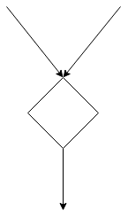
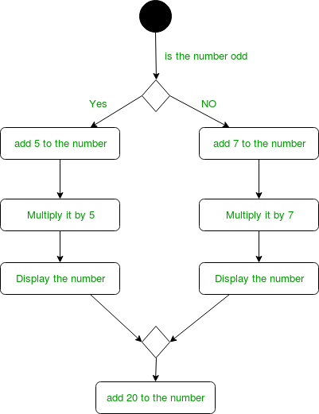
Merge or Merge Event – Scenarios arise when activities which are not being executed concurrently have to be merged. We use the merge notation for such scenarios. We can merge two or more activities into one if the control proceeds onto the next activity irrespective of the path chosen.
For example – In the diagram below: we can’t have both sides executing concurrently, but they finally merge into one. A number can’t be both odd and even at the same time..
Reference: https://www.geeksforgeeks.org/unified-modeling-language-uml-activity-diagrams/

Slide 10
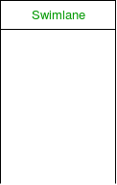
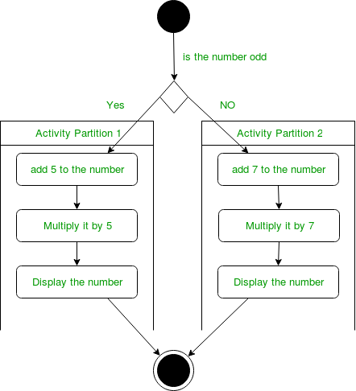
Swimlanes – We use swimlanes for grouping related activities in one column. Swimlanes group related activities into one column or one row. Swimlanes can be vertical and horizontal. Swimlanes are used to add modularity to the activity diagram. It is not mandatory to use swimlanes. They usually give more clarity to the activity diagram. It’s similar to creating a function in a program. It’s not mandatory to do so, but, it is a recommended practice.
We use a rectangular column to represent a swimlane as shown in the figure above.
For example – Here different set of activities are executed based on if the number is odd or even. These activities are grouped into a swimlane.
Reference: https://www.geeksforgeeks.org/unified-modeling-language-uml-activity-diagrams/

Slide 11

Final State or End State – The state which the system reaches when a particular process or activity ends is known as a Final State or End State. We use a filled circle within a circle notation to represent the final state in a state machine diagram. A system or a process can have multiple final states.
How to Draw an activity diagram –
Identify the initial state and the final states.
Identify the intermediate activities needed to reach the final state from he initial state.
Identify the conditions or constraints which cause the system to change control flow.
Draw the diagram with appropriate notations.
Uses of an Activity Diagram –
Dynamic modelling of the system or a process.
Illustrate the various steps involved in a UML use case.
Model software elements like methods, operations and functions.
We can use Activity diagrams to depict concurrent activities easily.
Show the constraints, conditions and logic behind algorithms.
Reference: https://www.geeksforgeeks.org/unified-modeling-language-uml-activity-diagrams/

Slide 12
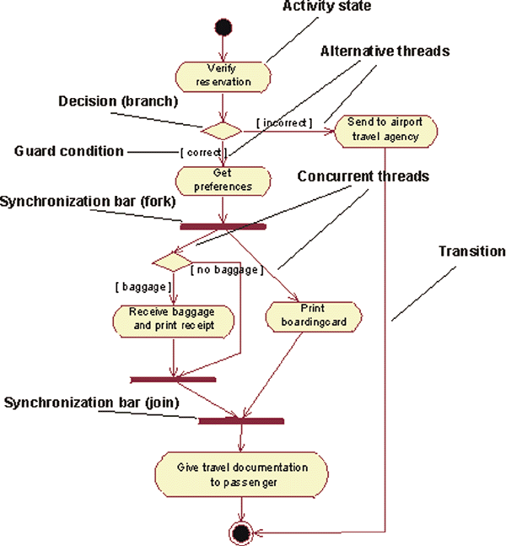
An Activity Diagram for the Business Use Case Individual Check-In in the Business Use-Case Model of Airport Check-in
Reference: https://www.ibm.com/developerworks/rational/library/2802.html/

Slide 13
Key references
Unified Modeling Language (UML): Complete Guide & Examples
-By James Rumbaugh, Ivar Jacobson, Grady Booch
https://www.geeksforgeeks.org/unified-modeling-language-uml-activity-diagrams
https://www.ibm.com/developerworks/rational/library/2802.html/

Slide 14
Thank You

